Slide 1
Let’s learn Pokémon theme song!
Gotta = got to
意思是「必須」去做某事
'em＝them

Slide 2
Listen and write.

Slide 3
Let’s check the answers!
I want to be the very best,
Like no one ever was.
To catch them is my real test,
To train them is my cause.

Slide 4
I will travel across the land,
Searching far and wide.
Teach Pokémon, to understand
The power that's inside

Slide 5
Pokémon (Gotta Catch 'em all)
It's you and me
I know it's my destiny
Pokémon!
You're my best friend
In a world we must defend

Slide 6
Pokémon (Gotta Catch 'em all)
A heart so true
Our courage will pull us through
You teach me and I'll teach you
Pokémon (Gotta catch 'em all)
Gotta catch 'em all

Slide 7
Homework this week
聽: Pokémon Theme Song。
說&讀:聆聽歌曲跟唱，完成請家長在
課本歌詞頁簽名，可換印章。
◎Mandy老師網頁: 信義國小-學校介紹-109行政及班級網頁-英語科任葉德涵老師

Slide 8
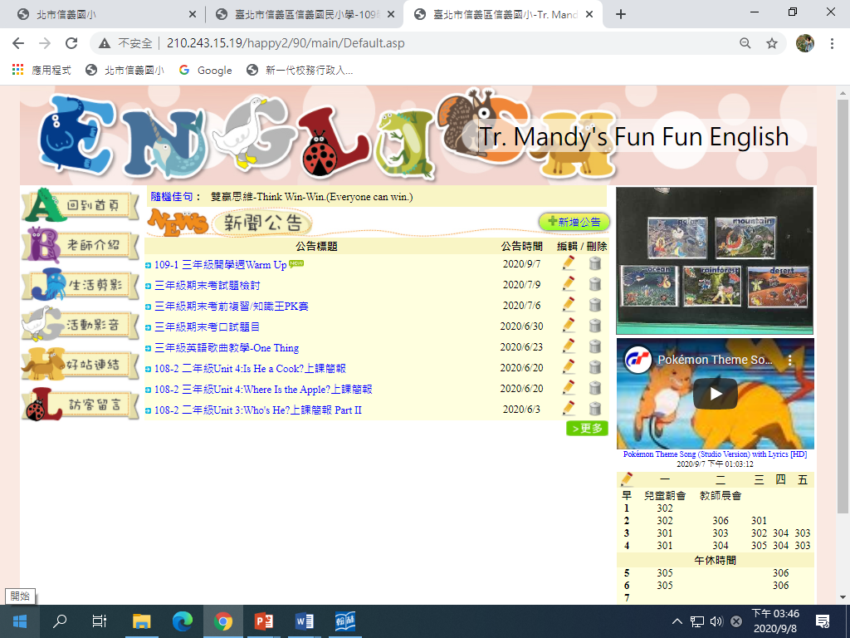
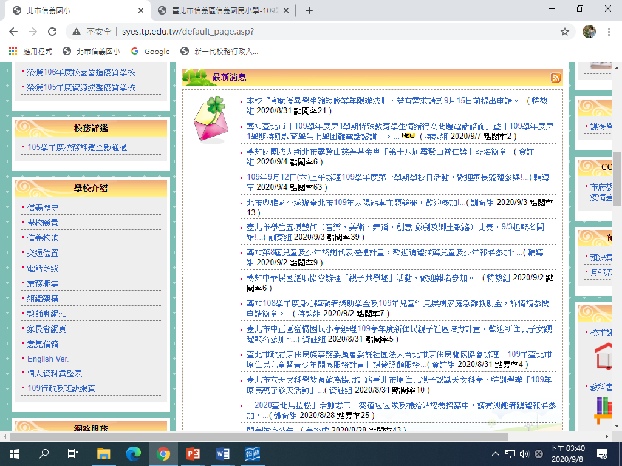
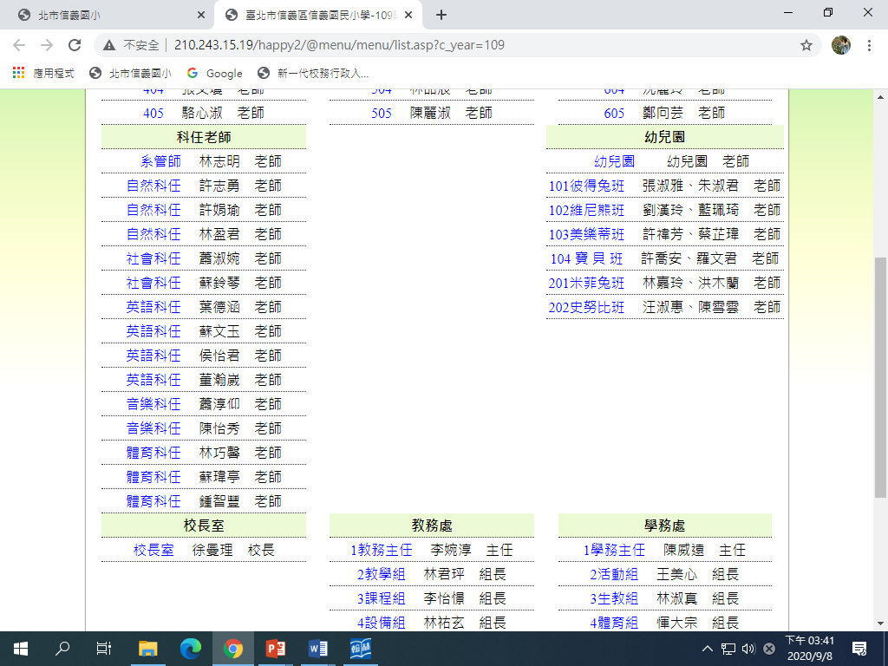

Slide 9
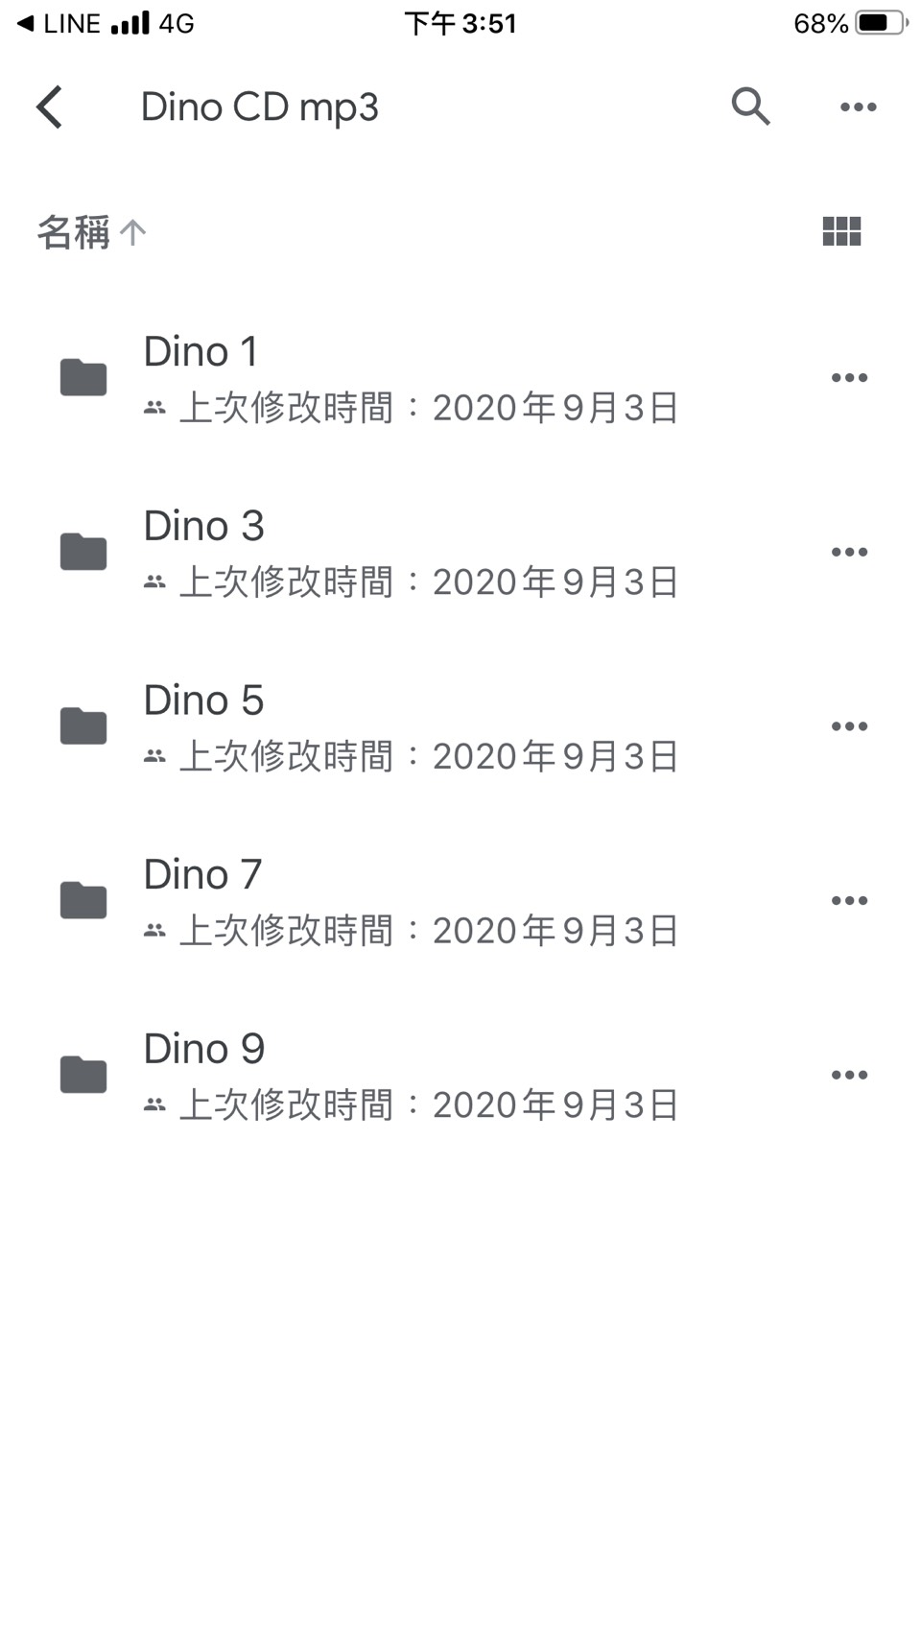
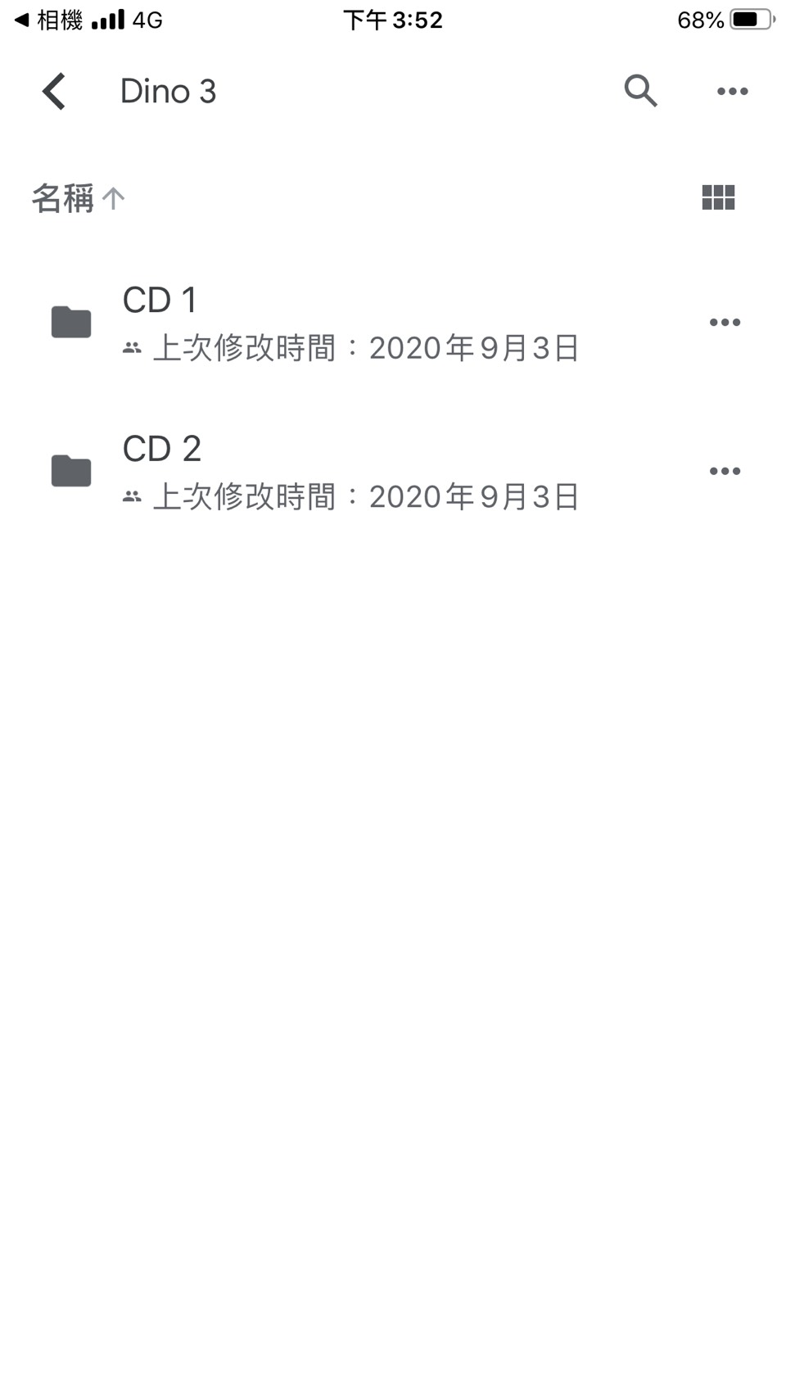
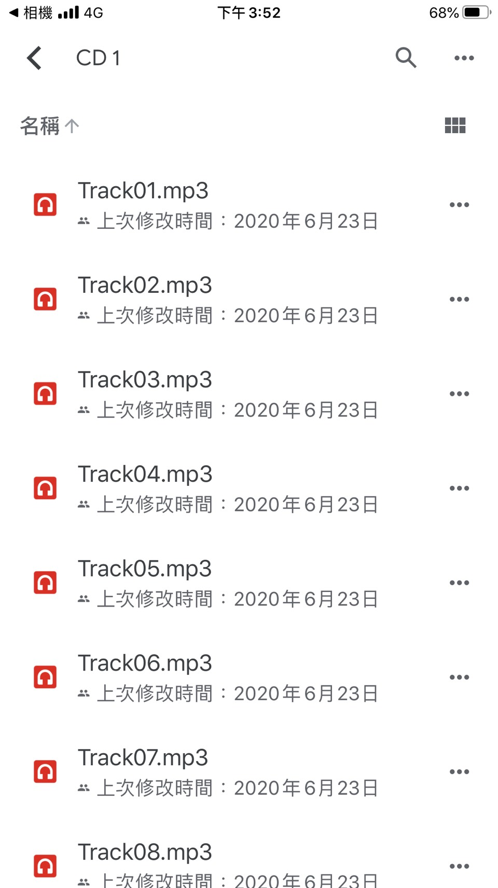
學生CD的MP3檔可掃QR code下載，每生英文課本&聯絡簿皆有貼紙。

